Slide 1
Data Mining Topic: Naïve Bayes Classifier
Dr. J Angel Arul Jothi
Department of Computer Science

Slide 2
Text Book Chapter 5
Sections 5.3.1, 5.3.2, 5.3.3

Slide 3
Bayes Classification
Bayesian classifiers
Statistical classifiers
Model relationship between the attribute set and the class variable in a probabilistic manner
Bayesian classification is based on Bayes theorem
Simple Bayesian classifier known as the naive Bayesian classifier
Bayesian classifiers have also exhibited high accuracy and speed when applied to large databases

Slide 4
Naive Bayesian classifiers
Naive Bayesian classifiers assume that the effect of an attribute value on a given class is independent of the values of the other attributes
This assumption is called class conditional independence
It is made to simplify the computations involved and, in this sense, is considered “naive.”

Slide 5
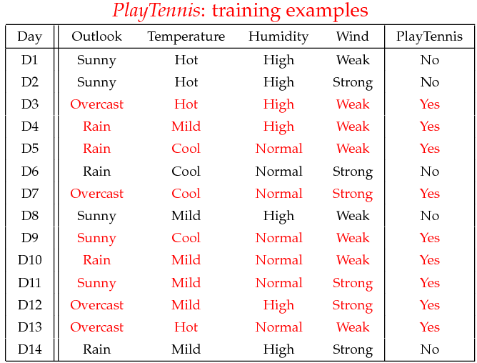
Example 1

Slide 6
Example 1
Given a test instance X find the predicted class label using Naive Bayes classifier
X=(Outlook=Sunny, Temperature=Cool, Humidity=High, Wind=Strong)
P(Outlook=Sunny|Play=Yes) = 2/9
P(Temperature=Cool|Play=Yes) = 3/9
P(Huminity=High|Play=Yes) = 3/9
P(Wind=Strong|Play=Yes) = 3/9
P(Play=Yes) = 9/14
P(Outlook=Sunny|Play=No) = 3/5
P(Temperature=Cool|Play==No) = 1/5
P(Huminity=High|Play=No) = 4/5
P(Wind=Strong|Play=No) = 3/5
P(Play=No) = 5/14

Slide 7
Example 1
P(Yes|X): [P(Sunny|Yes)P(Cool|Yes)P(High|Yes)P(Strong|Yes)]P(Play=Yes) = 0.0053
P(No|X):
[P(Sunny|No) P(Cool|No)P(High|No)P(Strong|No)]P(Play=No) = 0.0206
P(Yes|X) < P(No| X), we label X to be “No”

Slide 8
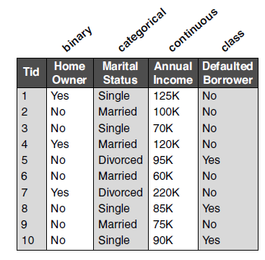
Example 2
Consider the training set. Given a test instance X find the predicted class label of the test instance using Naive Bayes classifier
X = home owner = No, Marital status = Married, Annual income = 120K

Slide 9
Example 2
P(X|Class=No) = P(Home Owner=No|Class=No) × P(Married| Class=No) × P(Income=120K| Class=No) × P(Class=No) = 4/7 × 4/7 × 0.0072 × 0.7= 0.0024
P(X|Class=Yes) = P(Home Owner =No| Class=Yes) × P(Married| Class=Yes) × P(Income=120K| Class=Yes) × P(Class=Yes) = 1 × 0 × 1.2 × 10⁻⁹ × 0.3= 0
Therefore P(No|X) > P(Yes|X) => Class = No

Slide 10
Thank you

